Slide 1

FAKE NEWS DETECTION USING MACHINE LEARNING
PRESENTED BY
NAME->Manas Raj

Slide 2
WHY I CHOSE THIS PROJECT
Fake news spreads very quickly through social media and websites.
It can mislead people and create confusion.
Machine Learning can automatically identify fake news with good accuracy.
This project demonstrates a practical use of Artificial Intelligence.

Slide 3
INTRODUCTION
Fake news is false or misleading information presented as real news. It spreads rapidly through social media platforms, messaging apps, and websites. Machine Learning helps analyse news articles and predict whether they are real or fake based on patter the text.

Slide 4
PROBLEM STATEMENT
Fake news spreads faster than verified information.
It can influence public opinion and decision-making.
Manual verification takes time and effort.
There is a need for an automated system to detect fake news accurately.

Slide 5
Limitations and future scope
Accuracy depends on the quality of the dataset.
New types of fake news may reduce prediction accuracy.
The model requires regular updates.
Future Scope
Improve prediction accuracy using deep leng.
Support multiple languages.

Slide 6
OBJECTIVE
Develop a Machine Learning model to detect fake news.
Classify news articles as Real or Fake.
Reduce the spread of misinformation.
Improve awareness of Al applications in everyday life.

Slide 7
technologyies used
Python
Machine Learning
Pandas
NumPy
Scikit-learn
VS code
Dataset(Real News and Fake News)

Slide 8
How the system works
1. Collect the news dataset.
2. Clean and preprocess the text.
3. Convert text into numerical features.
4. Train the Machine Learning model.
5. Enter a news headline or article.
6. The model predicts whether the news is Real or Fake.

Slide 9
advantages
Detects fake news quickly.
Saves time compared to manual verification.
Improves public awareness.
Easy to use.
Can be integrated with websites and social media platforms.

Slide 10
limitations
Accuracy depends on the quality of the dataset.
New types of fake news may reduce prediction accuracy.
The model requires regular updates.

Slide 11
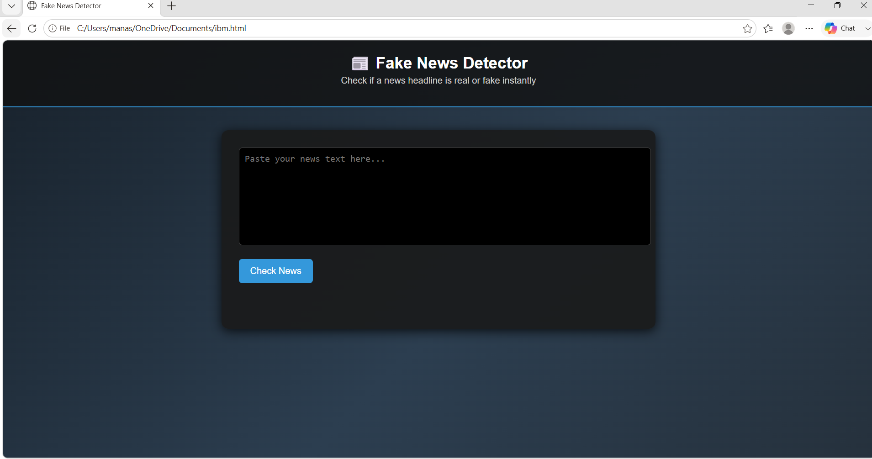

Slide 12


Slide 13


Slide 14
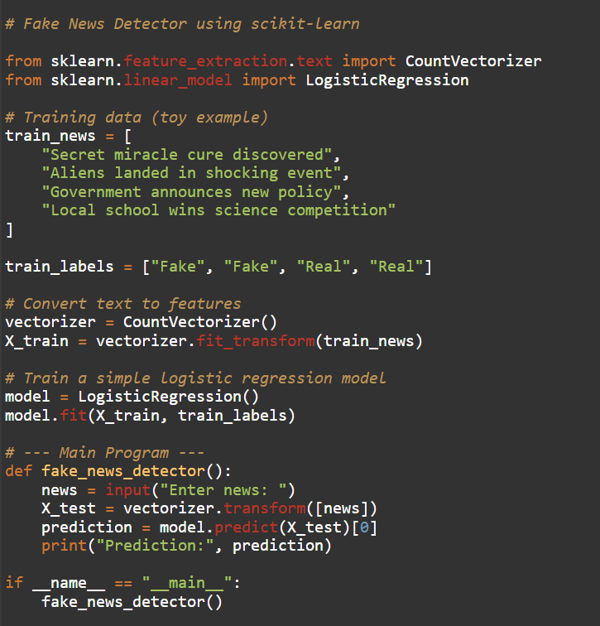



Slide 15
conclusion
Fake News Detection using Machine Learning is an effective solution for identifying false information. It helps reduce misinformation by automatically analysing news content. With improved datasets and advanced Al models, this technology can become even more accurate and useful in the future.

Slide 16


